Slide 1
Web Tier

Slide 2
Types of Web Applications:
1. Presentation-oriented: Generates interactive web pages containing markup language (HTML, XML, and so on)
2. Service-oriented: Implements the endpoint of a web service.

Slide 3
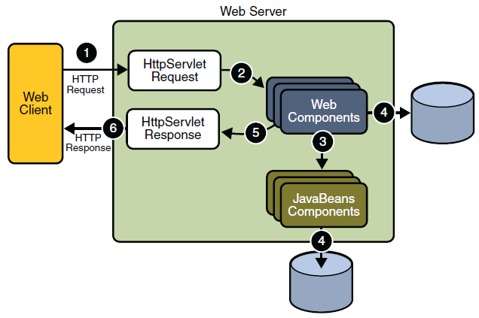
Java WebApplication RequestHandling

Slide 4
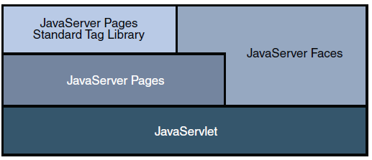
JavaWebApplication Technologies

Slide 5
Web Application Life Cycle
The process for creating, deploying, and executing a web application can be summarized as follows:
1. Develop the web component code.
2. Develop the web application deployment descriptor.
3. Compile the web application components and helper classes referenced by the components.
4. Optionally package the application into a deployable unit.
5. Deploy the application into a web container.
6. Access a URL that references the web application.

Slide 6
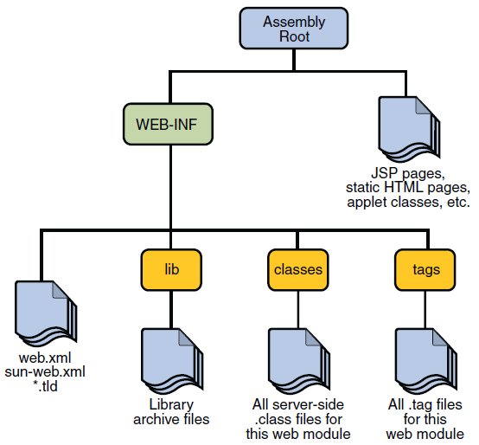
WebModule Structure

Slide 7
Java Servlet Technology
Servlet: A servlet is a Java programming language class that is used to extend the capabilities of servers that host applications accessed by means of a request-response programming model.
The javax.servlet and javax.servlet.http packages provide interfaces and classes for writing servlets.
The deployment descriptor (the web.xml file) includes the following configurations:
-A display-name element that specifies the name that tools use to identify the application.
-A set of filter elements that identify servlet filters contained in the application.
-A set of filter-mapping elements that identify which servlets will have their requests or responses filtered by the filters identified by the filter elements. A filter-mapping
element can define more than one servlet mapping and more than one URL pattern for a particular filter.
-A set of servlet elements that identify all the servlet instances of the application.
-A set of servlet-mapping elements that map the servlets to URL patterns.More than one URL pattern can be defined for a particular servlet.
-A set of error-page mappings that map exception types to an HTML page, so that the HTML page opens when an exception of that type is thrown by the application.

Slide 8
Servlet Life Cycle
The life cycle of a servlet is controlled by the container in which the servlet has been deployed.
When a request is mapped to a servlet, the container performs the following steps.
1. If an instance of the servlet does not exist, the web container
a. Loads the servlet class.
b. Creates an instance of the servlet class.
c. Initializes the servlet instance by calling the init method.
2. Invokes the service method, passing request and response objects.
If the container needs to remove the servlet, it finalizes the servlet by calling the servlet’s
destroy method.

Slide 9
Filtering Requests and Responses:
A filter is an object that can transform the header and content (or both) of a request or response.
The main tasks that a filter can perform are as follows:
-Query the request and act accordingly.
-Block the request-and-response pair from passing any further.
-Modify the request headers and data. You do this by providing a customized version of the request.
-Modify the response headers and data. You do this by providing a customized version of the response.
Interact with external resources.
Applications of filters include authentication, logging, image conversion, data compression, encryption, tokenizing streams, XML transformations, and so on.

Slide 10
Session Management
Getting object from session:
HttpSession session = request.getSession();
ShoppingCart cart = (ShoppingCart)session.getAttribute("cart");
Invalidating session after its purpose is solved:
session.invalidate();
The timeout period also be set in web.xml so that the session gets automatically invalidated.

Slide 11
SessionTracking:
If your application uses session objects, you must ensure that session tracking is enabled by having the application rewrite URLs whenever the client turns off cookies. You do this by calling the response’s encodeURL(URL) method on all URLs returned by a servlet. This method includes the session ID in the URL only if cookies are disabled; otherwise, it returns the URL unchanged.
If cookies are turned off, the session is encoded in the Check Out URL as follows:
http://localhost:8080/bookstore1/cashier;jsessionid=c0o7fszeb1
If cookies are turned on, the URL is simply
http://localhost:8080/bookstore1/cashier

Slide 12
Finalizing a Servlet by calling destroy() to release any resources the servlet is using and save any persistent state.
Nullifying all that objects that are used in the servlet.

Slide 13
JavaServer Pages Technology
JavaServer Pages (JSP) technology allows you to easily create web content that has both static and dynamic components. JSP technology makes available all the dynamic capabilities of Java Servlet technology but provides a more natural approach to creating static content.
The main features of JSP technology are as follows:
- A language for developing JSP pages, which are text-based documents that describe how to process a request and construct a response
- An expression language for accessing server-side objects
- Mechanisms for defining extensions to the JSP language

Slide 14
Sample JSP tags
<%@ page contentType="text/html; charset=UTF-8" %> - Page directive
<%@ taglib uri="/functions" prefix="f" %> - Tag library directive
<jsp:useBean - is a standard element.
${ } - JSP expression language expressions to retrieve the value of object properties
c:set, c:forEach, c:if, c:choose, c:when, c:otherwise - Custom tags

Slide 15
The Life Cycle of a JSP Page : A JSP page services requests as a servlet. Thus, the life cycle and many of the capabilities of JSP pages are determined by Java Servlet technology
Handling JSP Page Errors:
<%@ page isErrorPage="true" %> - This indicates that this jsp is acting as error page.
<%@ page errorPage="errorpage.jsp"%>

Slide 16
JavaBeans Components
JavaBeans components are Java classes that can be easily reused and composed together into applications. Any Java class that follows certain design conventions is a JavaBeans component.
<jsp:useBean id="beanName" class="fully-qualified-classname" scope="scope"/>
<jsp:useBean id="bookDB" class="database.BookDB" scope="page">
<jsp:setProperty name="bookDB" property="database" value="${bookDBAO}" />
</jsp:useBean>
Retrieving JavaBeans Component Properties:
<jsp:getProperty name="beanName" property="propName"/>

Slide 17
JavaServer Pages Documents
A JSP document is a JSP page written in XML syntax.Because it is written in XML syntax, a JSP document is also an XML document and therefore gives you all the benefits offered by the XML standard
- You can author a JSP document using one of the many XML-aware tools on the market,enabling you to ensure that your JSP document is well-formed XML.
- You can validate the JSP document against a document type definition (DTD).
- You can nest and scope namespaces within a JSP document.
- You can use a JSP document for data interchange between web applications and as part of a compile-time XML pipeline.
JSP page is identified as JSP document if
The file has extension as .jspx
The jsp page has jsp:root element
In web.xml file, set the is-xml element of the jsp-property-group element to true.

Slide 18
